Slide 1
The Swedish Institute Cooperation with Russia and the Baltic Sea Region
Cecilia Andrae, Saint Petersburg, 8 February 2017

Slide 2
The assignment today
SI is a public agency with mandate from the Parliament and Government
Foreign policy, international aid and development, reform cooperation, and education
Budget of SEK 460 million (in 2017)
Operations with three main orientations:
Image of Sweden
Sweden communication
Relationship-building activities

Slide 3
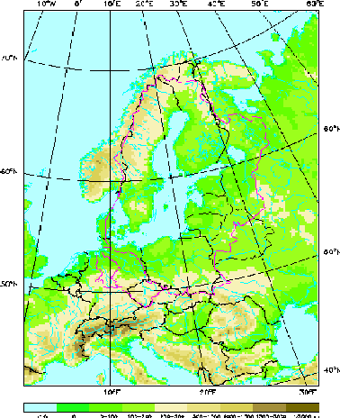
New five year strategy for Baltic Sea Region cooperation 2016-2020
The purpose is to develop Sweden’s relations in the Baltic Sea Region
Area 1: Sustainable development and strengthened global competitiveness for the Baltic Sea region
Area 2: Increased integration between EU Member States and the countries in the EU’s Eastern Partnership and Russia
Langaas , 1998
Notes:
.

Slide 4
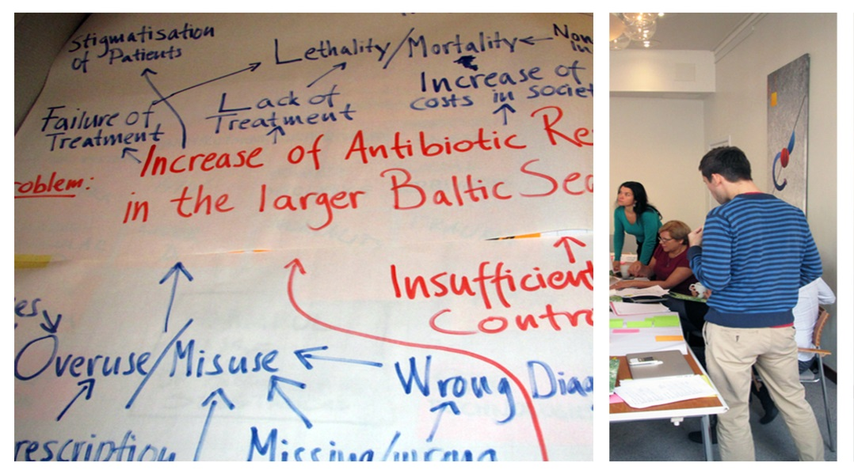
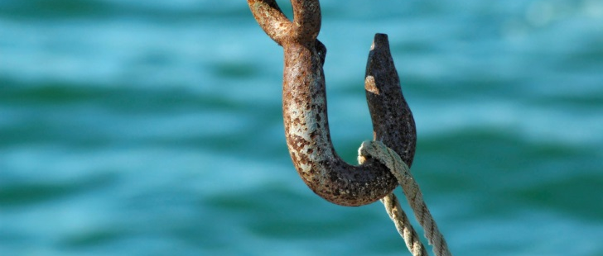
Cooperation with Russia and the Baltic Sea Region
People-to-people cooperation with Russia is a priority
Overall approach
Countries should meet regional challenges jointly
Strengthen relations, networks and long term mutual cooperation between Russian and Swedish organisations
Contribute to increased knowledge and capacity
Miriam Preis/imagebank.sweden.se

Slide 5
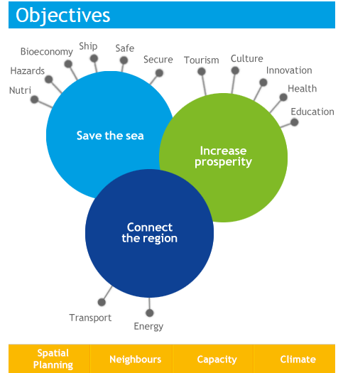
Areas for cooperation
EU Strategy for the Baltic Sea Region
(EUSBSR)
Notes:
Östersjö och Rysslandsprio i stort sett samma. Bortsett från 5015.

Slide 6
Swedish Institute activities
Financial support for project cooperation (Swedish applicant). Themes (ex): environment; health; society; civil security. Target groups: Civil society organisations, foundations, public sector agencies, academic sector, private sector agencies or other professional actors.
Scholarships for individual mobility (Master, PhD)
Events: seminars, exhibitions
Expert- and journalist visits
Leadership programmes. Themes (ex): labour mobility; bio-economy; public administration; culture/creative industries; sustainability
Example of a programme: Swedish Institute Management Programme for Northern Europe, SIMP NE
10 years in 2017

Slide 7
SIMP in 18 countries
Nothern Europe (since 2007): Belarus, Estonia, Latvia, Lithuania, Poland, Russia, Ukraine, Sweden
Africa:
Ethiopia, Kenya, Rwanda, Tanzania, Zambia
A unique business network with 600 members globally
Asia:
China, India, Indonesia, Thailand, Vietnam, Philippines

Slide 8
AIM of the SWEDISH INSTITUTE MANAGEMENT PROGRAMME
- SIMP
NEW KNOWLEDGE
Sustainable business
Responsible leadership
Holistic approach
Creating Shared Value
NEW NETWORKS
SIMP peers
SIMP Global Alumni Network
Swedish experts and business

Slide 9
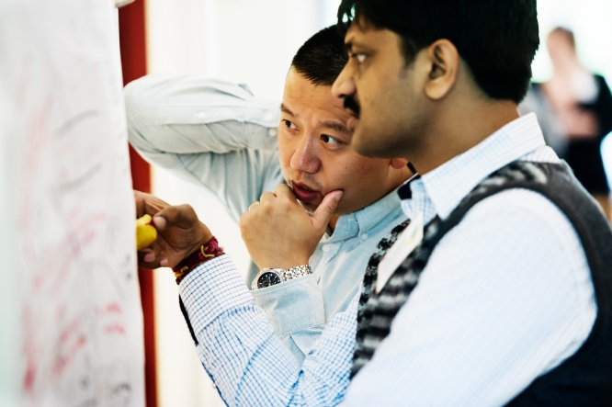
Participants of SIMP
5-10 years managerial experience
Focus on strategic business development
Interested in holistic approach to business
Diverse industrial backgrounds
Openminded and English speaking
Connector with a large network
Change makers for a more sustainable future
261 alumnis in Northern Europe – 54 from Russia

Slide 10
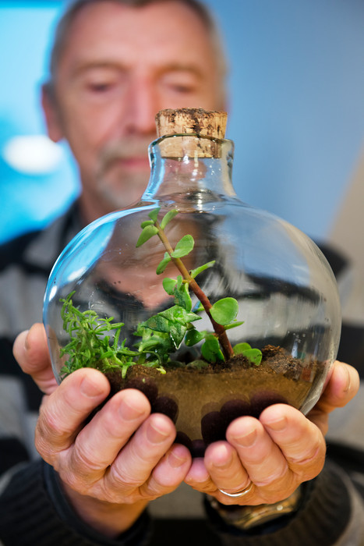
Conclusions
Relationship building activities are
are a long-term commitment
Mutual interest is important
for sustainability
SI facilitates cross-sectorial coope-
ration and networking in many
thematic areas
Photo: Cecilia Larsson Lantz

Slide 11
Cecilia Andrae, Regional Advisor
www.si.se
www.si.se/simpne

